Slide 1
Colours

Slide 2




#47a3b5
#15535f
#e0d7c7
#f1a638

Slide 3

#47a3b5
#15535f
#fadc82
#f1a638

Slide 4






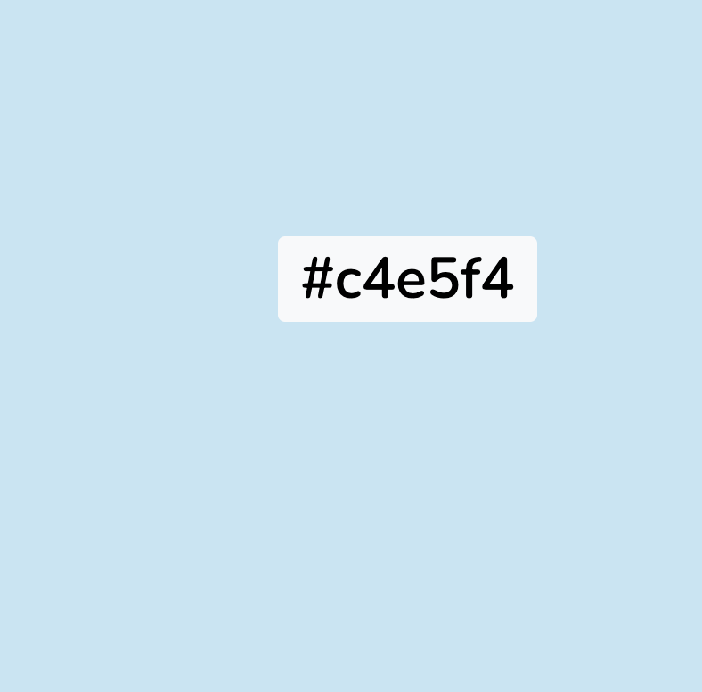







https://www.color-hex.com/color/bcd285
Aqua
Peacock
yellow
orange
olive
raspberry
Pale blue
Red
grey
Pale green
purple
pink
brown
charcoal

